Slide 1
Come-Talk
MADE BY: Team Farzi Coders
Harshit Saraswat
Ankit Mahendru
Sarvagya Tripathi
Harsh Singh
Manjeet Mann

Slide 2
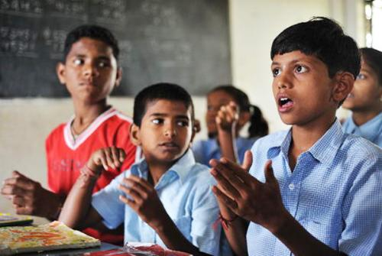
Introduction

Slide 3
The basic theme for Angel Hack 2019 is to develop a product which can be used to bring a change or solve even a small problem in real world scenario.
Just as we looked upon the themes a no. of ideas popped up onto our minds but the one which got glued to us is the Sign Language Recognition System and we name it as Come-Talk.
The basic idea behind Come-Talk is to recognize hand gestures from live camera feed and give output in the English language understandable by all.
Come-Talk might seem to be a small idea, but if you keep yourselves at the place of people who cant converse with others due to their lack of speech(or its knowledge), it’s a big life saver because now they can do daily tasks, indulge in conversations and live like a normal person freely without any hassles.
Sign languages are languages that use the visual-manual modality to convey meaning. Wherever communities of deaf people exist, sign languages have developed as handy means of communication and they form the core of local deaf cultures. Although signing is used primarily by the deaf and hard of hearing, it is also used by hearing individuals, such as those unable to physically speak, those who have trouble with spoken language due to a disability or condition (augmentative and alternative communication), or those with deaf family members, such as children of deaf adults.

Slide 4
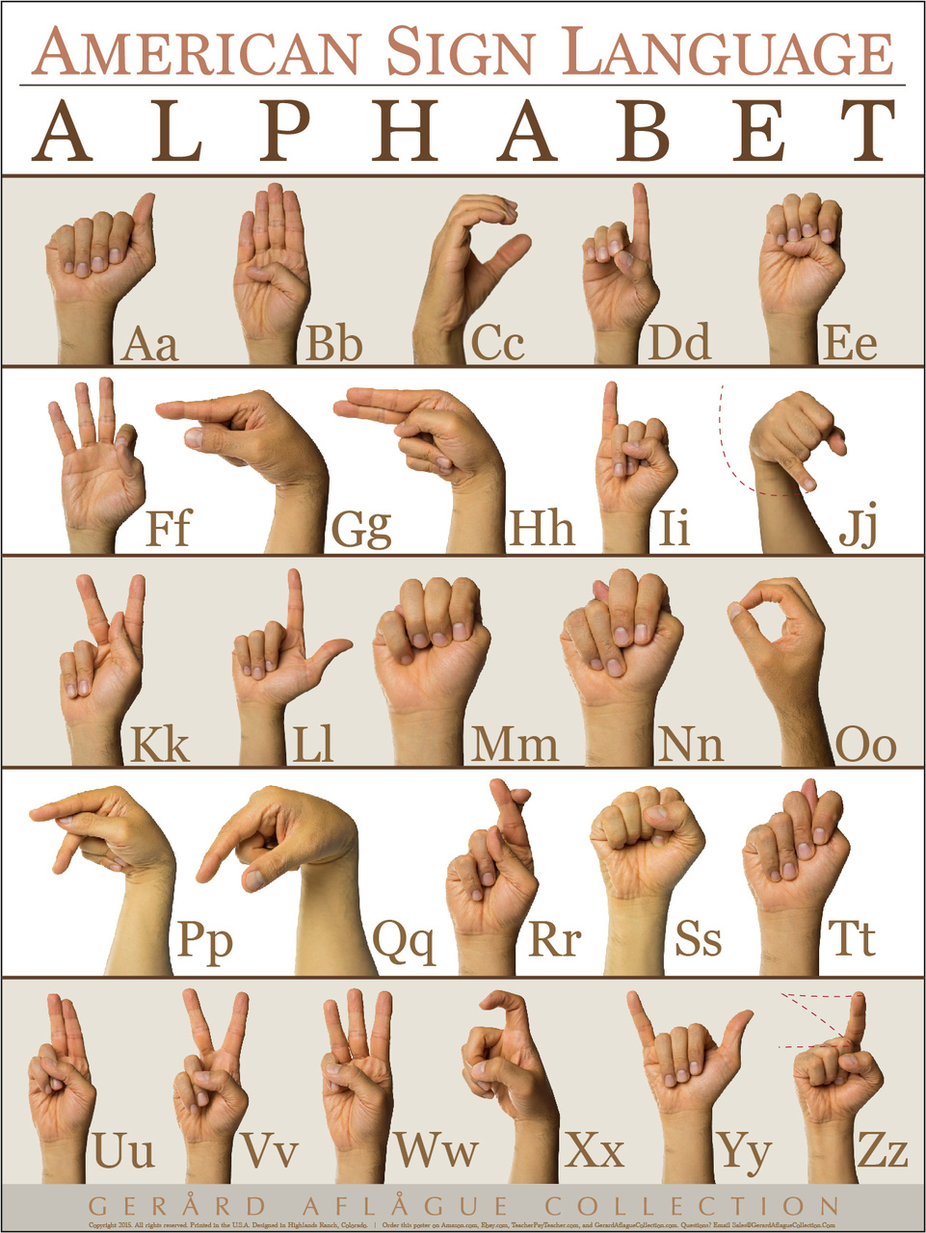

Slide 5
Working
The working principle of Come-Talk is a Sequential CNN based Image Classifier which classifies the images taken from camera into appropriate alphabet gestures and returns it labels.
To do so it first takes an input of the image and then converts it into a masked image so as to use image classification logic through a sequential neural network to produce an output.
The training of the model takes a few hours for giving us an accuracy of over 89%.

Slide 6
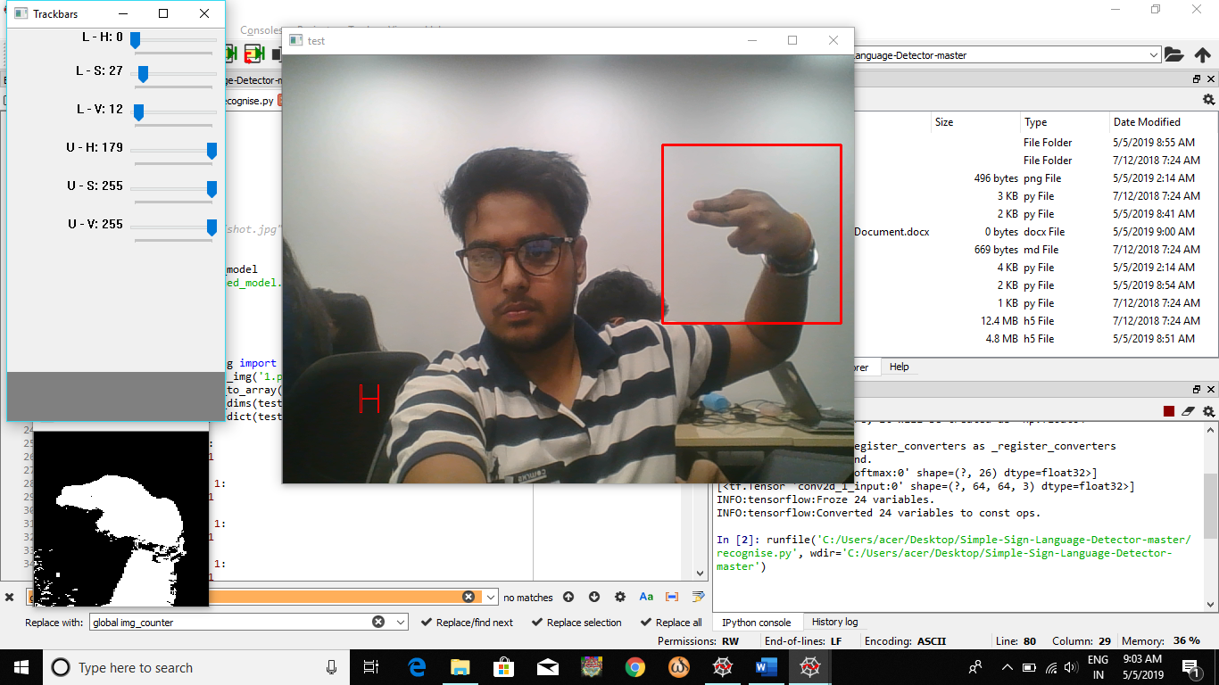
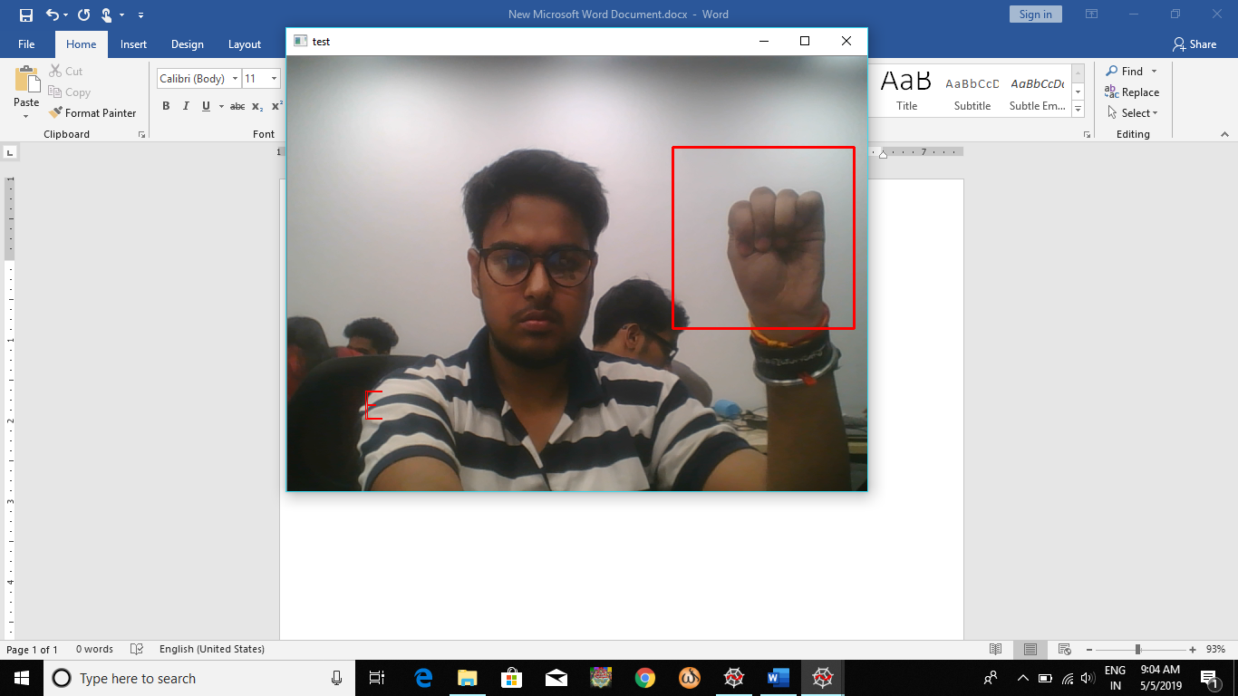
Screenshots

Slide 7
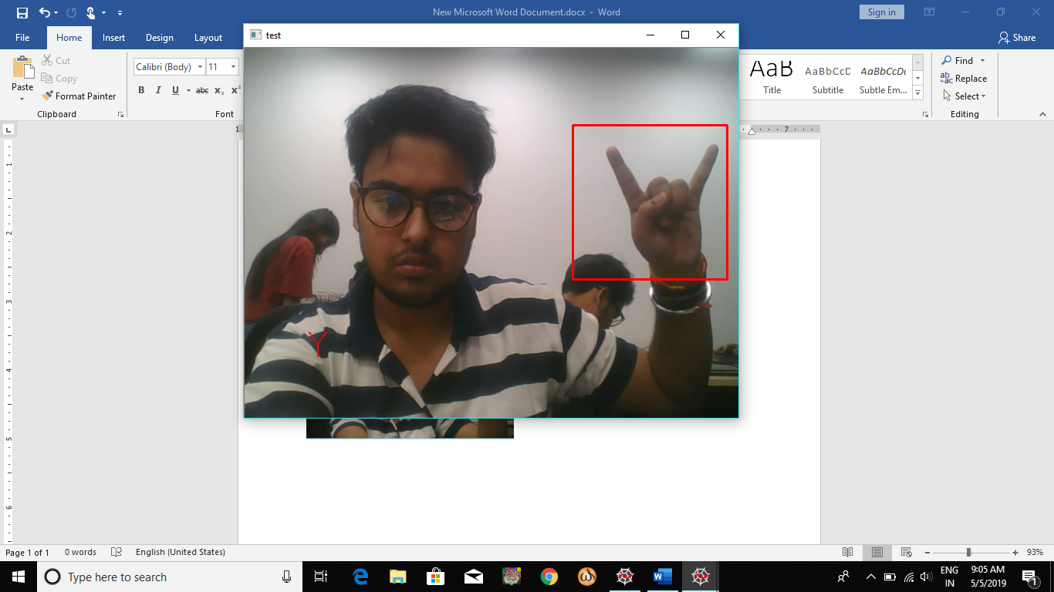
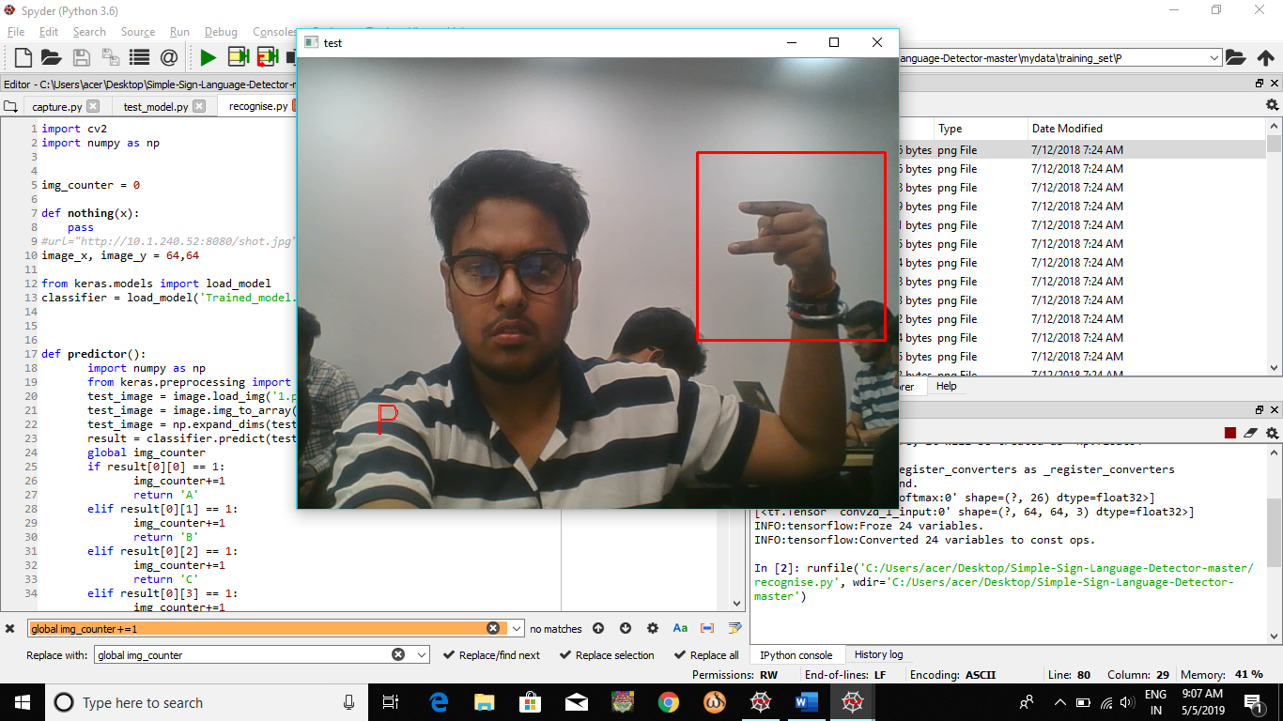
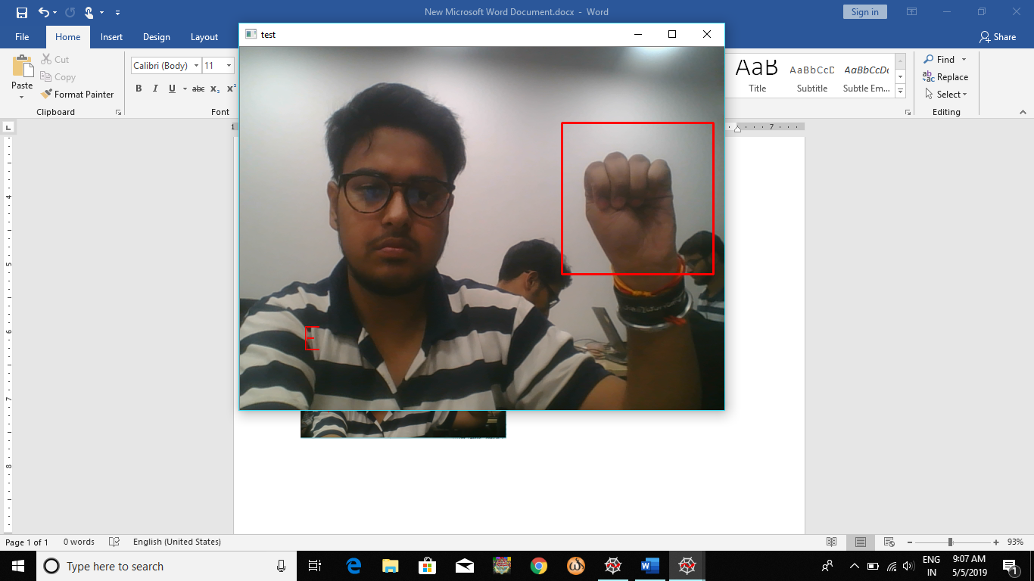
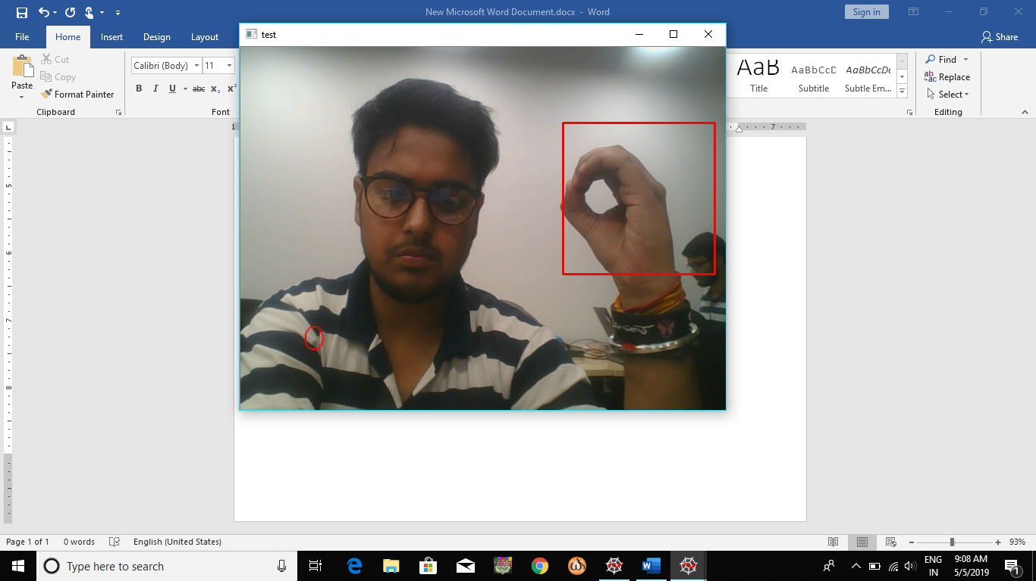

Slide 8
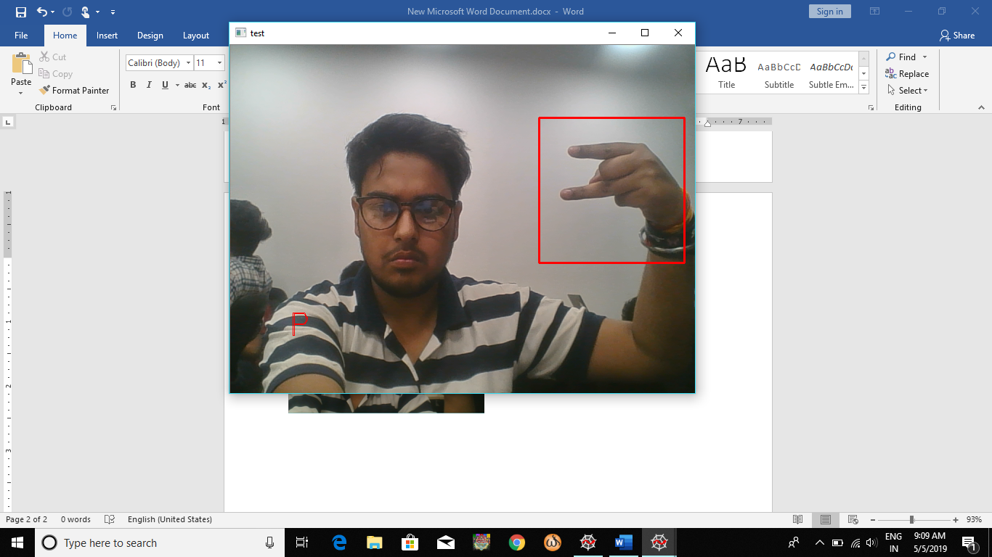
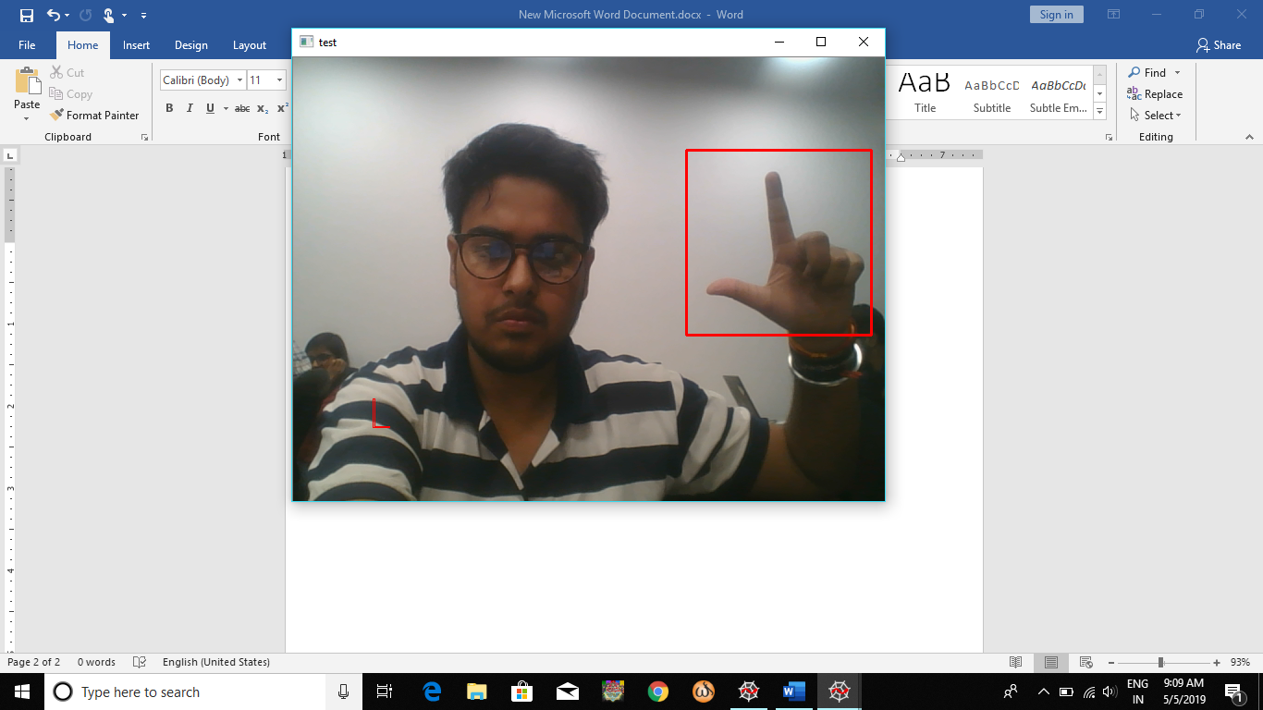
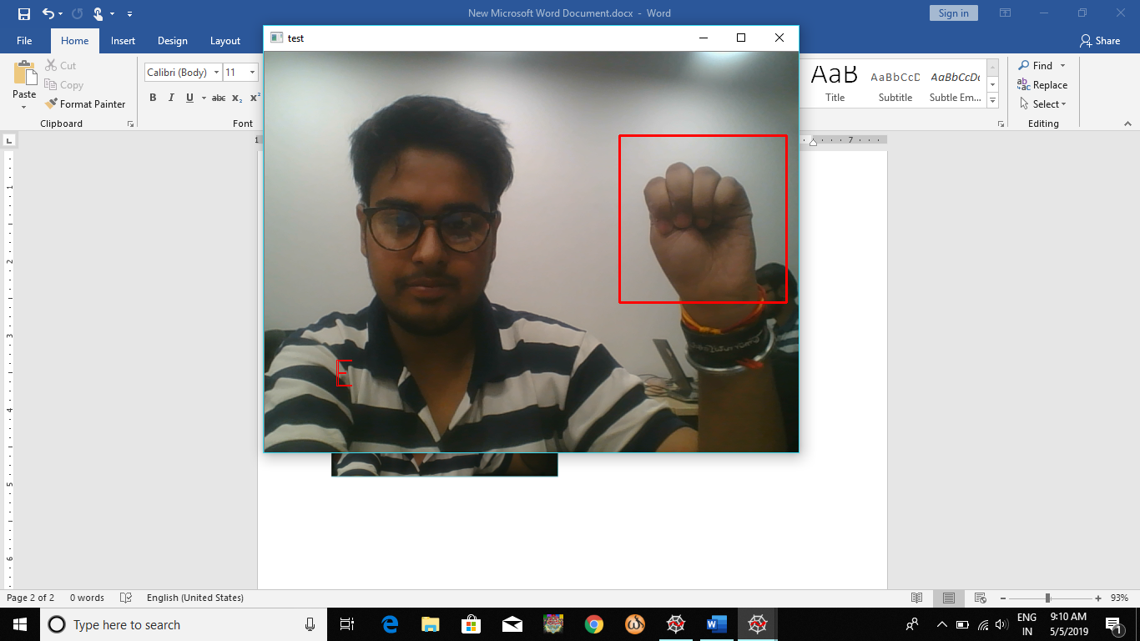

Slide 9
Future Scope
Deployment on different platforms.
To incorporate different languages(Hindi, Spanish, French, etc.)
Add numbers and other special symbols like space, @,#,!,&, etc.
Addition of text to speech and speech to text technologies.
Addition of sentiment analysis and NLP technologies.
Improved Accuracy.
Improved Performance and stability.

Slide 10


